Slide 1
Functions, Pointers, and Storage Classes

Slide 2
An Aside: Identifiers in Memory
Suppose we looked into 4 consecutive bytes of memory and found the following hexadecimal string: 0a3d70a4. It could be :
  Four characters, in this case: ‘\n’ ‘=‘ ‘p’ ‘\164’
  The long integer 171798692
  Two short integers 2621 and 28836
  The floating point number 1.04
  There are more choices, for example, two chars, and a short, etc.
The interpretation of the contents in memory is very important as this example shows. This is what data typing does. It supplies an interpretation to the values in an area of memory.
It is helpful to think as an identifier as a window that lets us look into memory and see the contents in a meaningful way. Sometimes, it is also helpful to think of this as an answering machine where we can leave a value for later use. The point is that knowing the interpretation (type) to apply to data in memory is just as important as knowing the location.

Slide 3
Pointer - The general idea
C provides call-by-value when a function is invoked. The called function receives copies of the parameters. Therefore, these parameters cannot be updated. A call-by-reference invocation would allow the called function to update its parameters. C provides the ability to perform call-by-reference through the use of pointers.
We have already seen this in scanf. When we say:
  scanf (“%d”, &x );
  The ‘&’ in front of the x, means the parameter being passed is a pointer to x rather than the value of x. A pointer is just the location in memory where the identifer is stored. Thus scanf does not receive the identifer x, it is told the address where x is stored. The type of the data is not discernible from the address, this is why you must describe it in your format string.
The ‘&’ character here is actually a unary operator, and has the same precedence as other unary operators.

Slide 4
Pointer Declaration
To declare a pointer to int, we would write:
  int a, b; *c; /* declares a, b as integers , and c as a pointer to int */
  Read *c as: c is a pointer to an int.
In most machines pointers are simply non-negative integers. (value 0 - highest-memory-reference-allowed)
The constant NULL is used to represent the value of a pointer that has not been given a value. (It is actually fixed as 0 in every machine I have ever seen.)

Slide 5
Pointer Assignment
int i, *p;
p = &i; /* p now “points to” i*/
p = 0; /* convention to say p points nowhere… */
p = NULL; /* The right way to say p does not point anywhere*/
p = ( int * ) 1307 /* points p at the absolute address 1307 in memory. */
  the (int *) casts 1307 as type pointer to int, this is necessary since only data of type pointer to int may be assigned to pointer to int.
  It would be rare to assign pointers this way, we seldom know the actual address in memory that will hold data.

Slide 6
Addressing and Dereferencing Pointers
Think of the using pointers as you would pronouns in English.
  int man1=22; /* a specific men */
  int man2=25; /* another specific men */
  int *he; /* he can refer to any man */
  he = &man1; /* he now refers to man1 */
To talk about the man he refers to, we dereference the pointer. This is done by preceeding he with a ‘*’ symbol. Dereferencing is also referred to as indirection.
  he = &man1; /* he now refers to man1 */
  *he = 23; /* man1 will now contain the value 4 */

Slide 7
Addressing and Dereferencing Pointers:
What is going on at declaration and assignment?
When we declare variables, storage is reserved for them somewhere in
memory. We will pretend that man1 will be stored at address 1004,
and man2 will be stored at address 1032. This is arbitrary and we
should not really care about the specific numeric addresses.
man1
int man1 = 22;
int man2 = 25;
int *he;
he = &man;
1004
22
man2
1032
25
he
1088
The declaration sets up the storage for the pointer he.
The assignment gives it its value
he
1088
1004

Slide 8
Addressing and Dereferencing Pointers:
What is going on during dereferencing?
man1
intman1=22;
int *he;
he = &man1;
*he = 23;
1004
22
he
1088
The declaration sets up the storage for the pointer he.
The assignment gives it its value
he
1088
1004
he
man1
1088
1004
1004
23

Slide 9
Addressing and Dereferencing Pointers:
Final Point
We normally don’t care about the specifics of the address. Here is how the same example works without worrying about actual addresses in memory.
man1
Int man1=22;
int *he;
he = &man1;
*he = 23;
22
he
he
he
man1
23

Slide 10
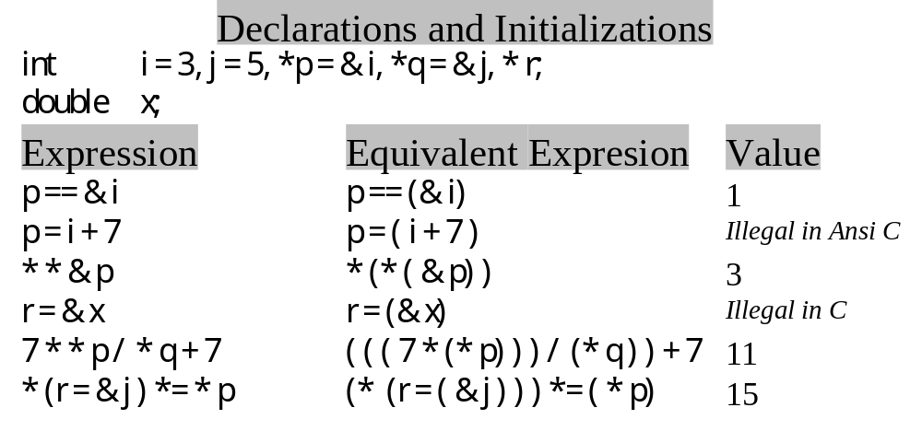
Precendence Rules
Remember: ‘&’ and ‘*’ are unary operators. They have the
same precedence rules as unary operators and are performed
from right to left.

Slide 11
Example of dereferenced pointer
#include <stdio.h>
int main(void) {
int i= 777, *p = &i;
printf ( “ Value of i: %d\n”, *p);
printf ( “ Address of I: %u or %p\n”, p, p );
return 0;
}
Output of this program:
Value of i: 777
Address of i: 234880252 or dfffcfc

Slide 12
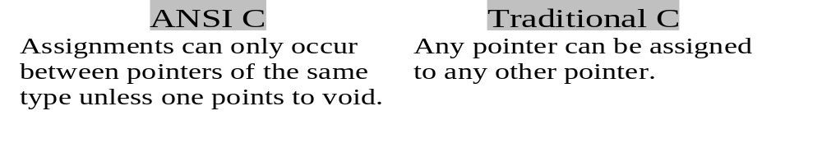
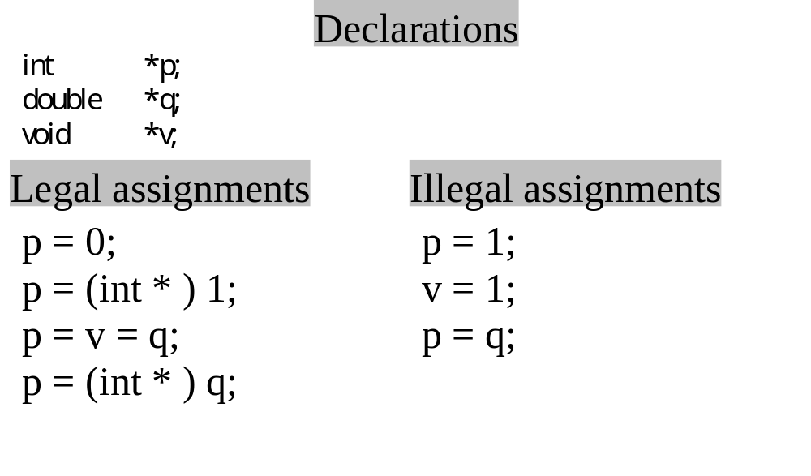
Pointers to void

Slide 13
Call-by-Reference
We have seen call-by-reference when we use the scanf function. Values supplied by the calling function as parameters cannot be updated by the called function. When we want a called function to update an identifier in the calling function, we pass it a pointer to the identifier. Call-by-value is still in effect, the called function cannot update the calling function’s pointer, but it can dereference the pointer to refer to the memory location of the calling function’s identifier. It can update the value at that memory location, in effect implementing call-by-reference.

Slide 14
Call-by-reference example: The swap program
#include < stdio.h>
void swap ( int *, int *) ;
int main( void ){
int a = 3, b = 7;
printf (“%d %d\n”, a, b); /* 3 7 is printed */
swap (&a, &b);
printf (“%d %d\n”, a, b); /* 7 3 is printed */
return 0;
}
void swap( int *p, int *q){
int tmp;
tmp = *p;
*p = *q;
*q = tmp;
}

Slide 15
Swap program: a closer look
swap (&a, &b);
First, the addresses of a and b are determined. These addresses are placed on the stack. Then control is passed to the swap function.
void swap( int *p, int *q){
When the swap function is invoked, the first
thing to happen is that the values from the
stack are (in effect) copied to their respective
parameters. So now: p ==> a and q ==> b.
p
a
3
q
b
7
tmp = *p;
dererencing p takes us to the location holding the value for identifier a. The contents of that location are copied into the identifier tmp. It is not true that tmp and a are the same place, they only have the same value.

Slide 16
Swap program: a closer look -2
*p = *q;
On the right hand side of an assignment operator, the pointer q is dereferenced to obtain the value 7.
This is used to update the memory location referred to by the dereferencing of p. Since, p “points to” a, it is the memory location referenced by a that is updated.
p
a
/
37
q
b
7
*q = tmp;
The contents of tmp (currently 3) are copied into the location obtained by dereferencing q. We see that is actually the memory location referred to as “b” in the calling function.
p
a
/
37
q
b
/
73
The net effect is that swap has “swapped” the callers contents of a and b.

Slide 17
Call-by-Reference Bottom Line
The effect of call-by-reference is accomplished by:
  Declaring a function parameter to be a pointer.
  Using the dereferenced pointer in the function body.
  Passing an address as an argument when the function is called.

Slide 18
A Block and Rules for Identifier Scope
A block is a compound statement having declarations. For example, a function body is a block.
Scope refers to the parts of a program that can validly reference an identifier. Informally, this is known as where the identifier can be seen.
The scope rule:
  Identifiers are accessible (i.e. can be seen) only within the block in which they were declared.
This is why one function cannot “see” the data within another function.

Slide 19
Scope Rules: Example The Block Scope Program
/* The Block Scope program. */
#include <stdio.h>
int main(void){
int a = 2, b = 1; /* outer block a and b*/
int *p = &a;
printf (“%d\n”, a); /* 2 is printed */
{
int a = 7; /* inner block a */
printf (“%d %d\n”, a, b); /* 7 1 is printed */
printf(“%d\n”, *p); /* 2 is printed */
} /* back to the outer block */
printf (“%d\n”, ++a); /* 3 is printed */
return 0;
}

Slide 20
Storage Classes
The storage class tells us the visibility and lifetime of a variable in a C program.
  By visibility we mean the extent to which it is accessible to statements in C programs.
  By lifetime we mean the length of time for which the variable actually exists in storage.
The storage classes for C identifiers:
  auto
  extern
  register
  static

Slide 21
The storage class auto
An automatic variable is declared within a function body. Every variable we seen so far is automatic.
  When a block is entered, storage for the automatic variables in it are allocated, and their initial values (if any) are set. Storage for these values only exists while the block is being executed.
Automatic variables are frequently referred to as local variables since they are only locally visible. However, local variables are truly determined by scope. As we shall see, some local variables are not of storage class auto.

Slide 22
Example of storage class auto behavior
#include <stdio.h>
void autoprinter(int j);
int main(void){
int j;
for (j = 0; j < 5; j++)
autoprinter( j );
return 0;
}
void autoprinter(int j){
int k = 1;
printf (“j = %d k = %d\n”, j, k++);
}
This program produces the following output:
j = 0 k = 1
j = 1 k = 1
j = 2 k = 1
j = 3 k = 1
j = 4 k = 1

Slide 23
The storage class extern
Variables declared outside of functions are of storage class extern. No keywords are necessary, rather the placement of the declaration within the file determines the storage class.
Variables of extern storage class are visible in all functions that follow their declaration in a file. Storage for extern variables is allocated once when the program begins and remains for the life of the program.
Variables of extern storage class are frequently referred to as global variables.
Variables of storage class extern cannot be register or auto.
All functions are extern storage class.

Slide 24
Do we need function parameters given global variable capability.
Communication through parameters is usually the preferred way of communication between functions.
  Global variables can be modified by any function within a program as a side effect of execution of the function. It can be exceedingly difficult to determine all of the possibilities by which global variables can be updated and what their values might be when a function is invoked. This can make it very difficult to maintain programs that make extensive use of global variables.
  When the same input may be treated differently depending on data that has been previously processed, the program is said to have state. The findyes program had state, it acted differently when it saw an ‘e’ depending on whether it had just seen a ‘y’. Global variables cause programs to have state when we may note want them to.

Slide 25
Example of confusion from having state
#include <stdio.h>
int a = 4, b = 0;
void function1(void){
if ( b-- > 0 ) a++;
}
void function2(void){
if ( b++ < 0 ) a--;
}
void function3(void){
a = 2;
}
int main(void){
int j;
while (scanf (“%d”,j)) > 0){
if (j == 0 && a == 2)
function1();
else if (j > 0 && a > 2)
function2();
else if (j < 0 && a < 2)
function3();
}
}
Question: Can a ever be 0? Was it hard to figure that out?

Slide 26
Another example of confusion from having state
#include <stdio.h>void function1(int *a, int *b){
if ( *b-- > 0 ) *a++;
}
void function2(int *a, int *b){
if ( *b++ < 0 ) *a--;
}
void function3(int *a){
*a = 2;
}
int main(void){
int j;
int a = 4, b = 0; /* Variables local to main also exist for the life, */
while (scanf (“%d”,j)) > 0){ /* of a program. If &a and &b are always */ if (j == 0 && a == 2) /* passed, they might just as well be global */
function1(&a ,&b); /* because the contents can be changed anywhere. */
else if (j > 0 && a > 2)
function2(&a ,&b);
else if (j < 0 && a < 2)
function3(&a );
}
}
Question: Can a ever be 0? Was it hard to figure that out?

Slide 27
Example of storage class extern
#include <stdio.h>
int a = 1, b = 2, c = 3; /* global variables (extern storage class) */
int f(void); /* function prototype */
int main(void){
printf(“%3d\n”, f()); /* 12 is printed */
printf(“%3d%3d%3d\n”, a, b, c); /* 4 2 3 printed */
return 0;
}
int f(void){
int b, c; /* b, and c are local variables */
/* global copies of b and c are masked */
a = b = c = 4; /* global variable a and local b, c updated */
return (a + b + c);
}

Slide 28
What is a register?
A register is very high speed memory. Typical machines have a very small number of registers, often 16. Programs copy data into registers from regular memory (RAM) and then operate on it. For a number in memory to undergo arithmetic it must first be copied into a register and the result copied back to memory. When a byte of data is to be copied from one location to another in memory, on most computers, it is copied into a register from the original location and then copied out of the register into the destination location. In short, registers are very fast memory and their contents are usually short-lived.

Slide 29
The storage class register
The storage class register suggests to the compiler that a variable be kept only in a register. Automatic variables in short-lived functions are reasonable candidates if they are very frequently referenced. The overhead of reading and writing to memory is avoided and the performance improvements can be dramatic.
The downside of register variables is that each register variable used removes a possible register the compiler might be able to use in improving speed of the code. (Remember there are not very many registers on most machines.)
Consider using register variables for the indices of an innermost loop.
Declaring a variable to be storage class register does not guarantee that the compiler will use a register for it, it is only a suggestion to the compiler that will be followed if it is physically possible and makes semantic sense.
If you declare a variable to be of storage class register, declare it as close to its place of use as possible. If the compiler uses a register for the variable the register is unavailable for other purposes during the entire life of the variable.

Slide 30
Static Storage Class
Static variables are variables that exist for the life of the program. They are truly the opposite of automatic variables.
Using a static variable as a local variable, even a called function can retain private information from one invocation to the next. This is sometimes used to make a function act differently the first time it is called in a program. (As an alternative to priming the pump.)
Static variables can only be seen within functions that are defined after the static variable appears in the source file. If they are at the top of the file, all functions in that file may “see” them but all functions in other source files may not. If they appear between functions in a source file, those defined above can’t “see” them while those below can.

Slide 31
Static (internal) variable example
void f(void){
static int cnt=0;
++cnt;
if (cnt % 2 == 0)
…. /* do something */
else
….. /* do something different */
}

Slide 32
Static External Variable Example
void f(void){
….. /* v is not available here */
}
static int v;
void g(void){
…….. /* v can be used here */
}

Slide 33
Default Initialization
External and static variables that are not explicitly initialized are initialized to zero by the compiler.
There is no guarantee as to the contents of uninitialized automatic variables, some implementations will initialize them to 0, in other implementations the contents will be dependent on the current values that happen to be on the stack. (In other words, anything…..) IF YOU HAVE AN AUTOMATIC VARIABLE MAKE SURE IT HAS A VALUE BEFORE YOU USE IT. This can often be done with your declaration but sometimes it can wait.
  e.g. the first part of a for statement can be used to initialize loop variables.

Slide 34
Word finder program
Creation of a program that:
  reads characters from input stream until EOF
  changes lowercase to uppercase
  prints three words to a line with a single space between each word.
  Count the number of characters read and the number printed.
    A word for this program is a sequence of non-white space characters of maximal length. ( i.e. all the stuff between white space or the first text up to white space and the last text up to white space.)

Slide 35
Word finder program - main function
#include <stdio.h>
#include <ctype.h>
#define NWORDS 3 /* number of words per line */
int process(int *, int *, int *);
int main(void){
int c, nchars = 0, nletters = 0;
while (( c = getchar( )) != EOF )
if (process ( &c, &nchars, &nletters) == 1)
putchar ( c );
printf (“\n%s%5d\n%s%5d\n\n”,
“Number of characters:”, nchars,
“Number of letters: “, nletters);
return 0;
}

Slide 36
Word finder program - process function
int process(int *p, int *nchars_ptr, int *nletters_ptr){
static int cnt = 0, last_char = ‘ ‘;
if (isspace (last_char) && isspace (*p))
return 0;
if (isalpha (*p)){
++ *nletters_ptr;
if (islower(*p))
*p = toupper(*p);
}
else if (isspace(*p))
if (++cnt % NWORDS == 0)
*p = ‘\n’;
else
*p = ‘ ‘;
++ *nchars_ptr;
last_char = *p;
return 1;
}

Slide 37
Function Declarations and Definitions
A function has been declared to the compiler when it first sees:
  a function definition;
  a function prototype or explicit declaration;
    An explicit declaration is a declaration of a function that does not identify the number and types of parameters. A prototype does identify both number and types of parameters.
  An invocation of the function;
    the compiler treats this as if an explicit declaration were made for a function returning an int. (This is default function declaration.)
In general, it is a good idea to avoid default function declaration.
Function storage class rules:
  functions can be either extern or static but not both. (visibility)
  Functions cannot be auto or register. (lifetime of storage)
Function parameter rules:
  Only the storage class register can be used for parameters.
  Parameters cannot be initialized.

Slide 38
Type qualifiers const and volatile
Type qualifiers tell the compiler how an identifier can be used. ANSI C adds to traditional C the qualifiers const and volatile.
  const tells the compiler that the value of the identifier will not be changed by any compiled code. Example:
  const double a=8; /* a has the value 8, no statements will change it. */
  volatile tells the compiler that the value of the identifier may be changed due to action of the hardware. Example:
  extern const volatile int real_time_clock;
    real_time_clock changes its value as time passes. It is visible to the program through the declaration. Because it is extern, no storage in this program is reserved for it (It is stored elsewhere.) Note this is also declared as const, this tells the compiler that the program will not update it. The qualifier const does not mean the value never changes, simply that the program won’t change it.

Slide 39
Programming Style
If you have a pointer and it will always point to the same identifier, either prepend it with p_ or append a _ptr to the identifiers name. For example:
  int k;
  int *p_k; /* good name for a pointer always pointing to k */
  int *k_ptr; /* another good way to name the pointer */
If the pointers don’t always point to the same identifer (and this will be the case most times.) Consider names that start with p1, p2, but better yet use a meaningful name after the p_ or before the _ptr. For example:
  int *p_smaller; /* p_smaller points to the smaller of x or y. */
  if (x< y)
  p_smaller = &x;
  else
  p_smaller = &y;

Slide 40
Common programming errors
The following makes p point at absolute location 3 (actually you get an error from an ANSI C compiler like gcc.) It does NOT put a 3 in the integer p points to.
int *p=3;
Using the same name for pointers and the identifiers they point to is an invitation for trouble. You will be much more likely to make mistakes if your code looks like:
  int j,k;
  swap(&j, &k);
  …
  void swap( int *j, int *k){
  …
  Than if it looks like this:
  int j,k;
  swap(&j, &k);
  …
  void swap( int *p_j, int *p_k){
  …

